Slide 1
QA Project
Satish Jethwa

Slide 2
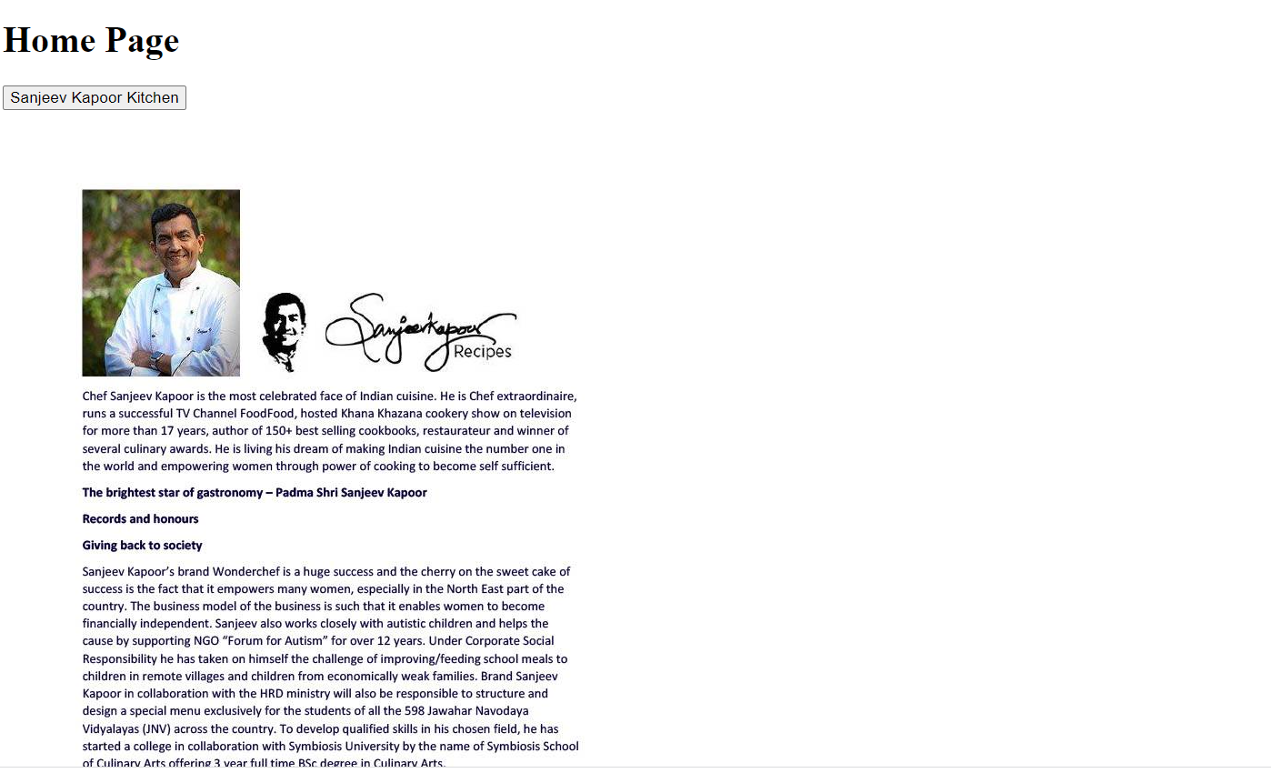
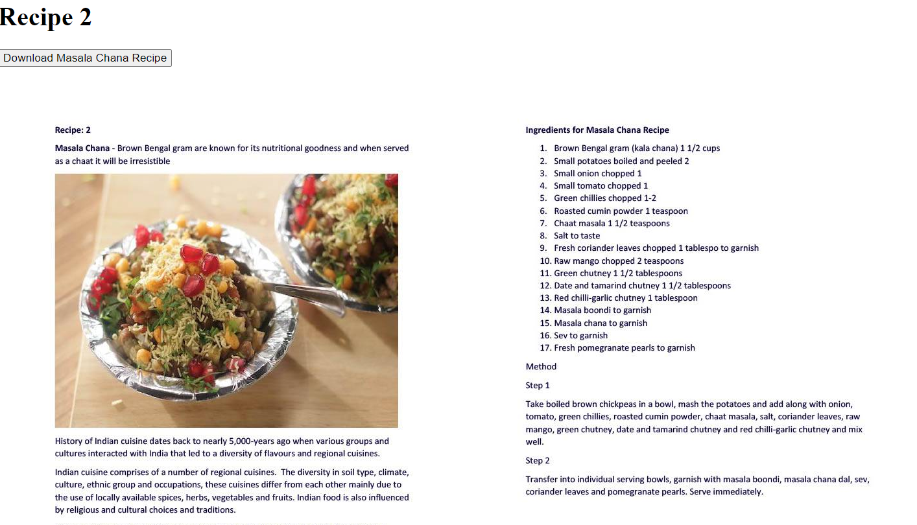
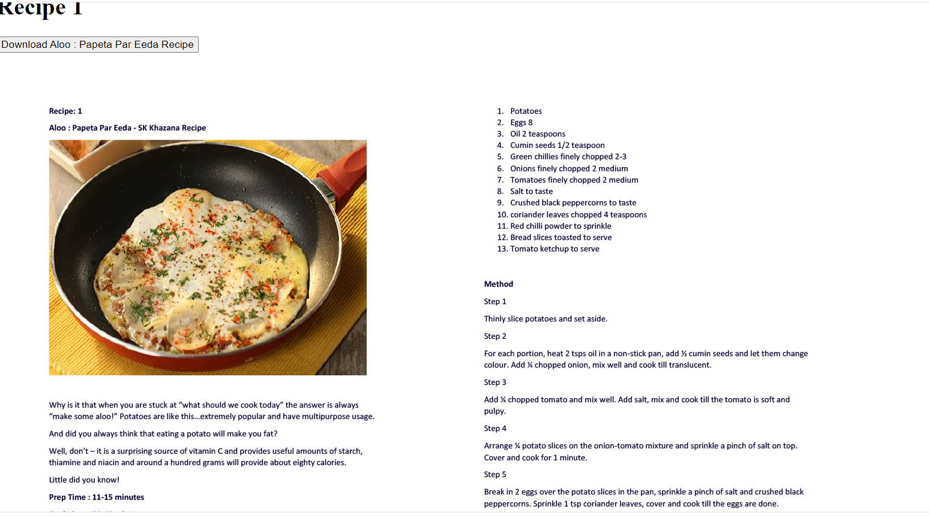
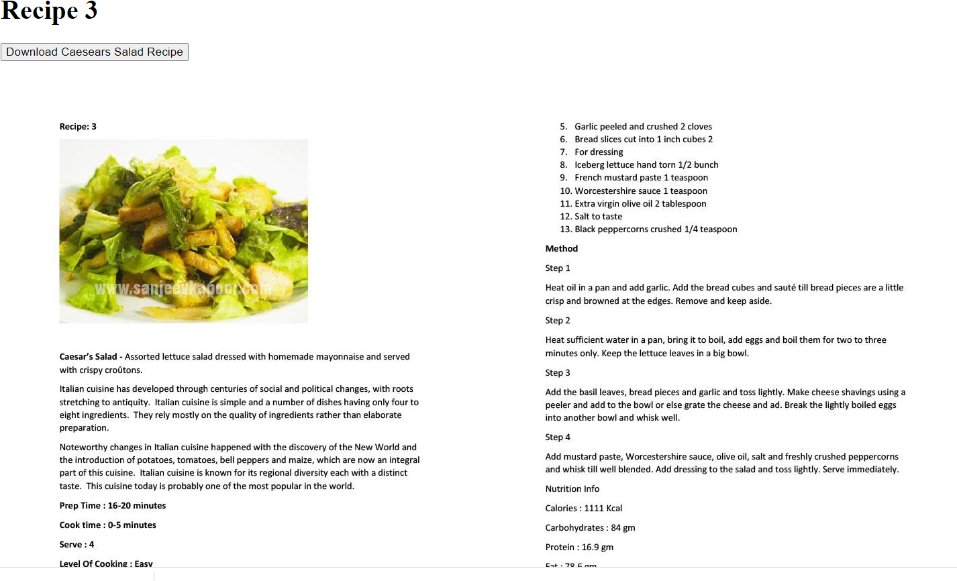
Create Web App with Database
Project is to link up a Celebrity Chef with choice of 3 recipes for the user to select.

Slide 3
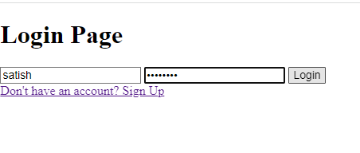
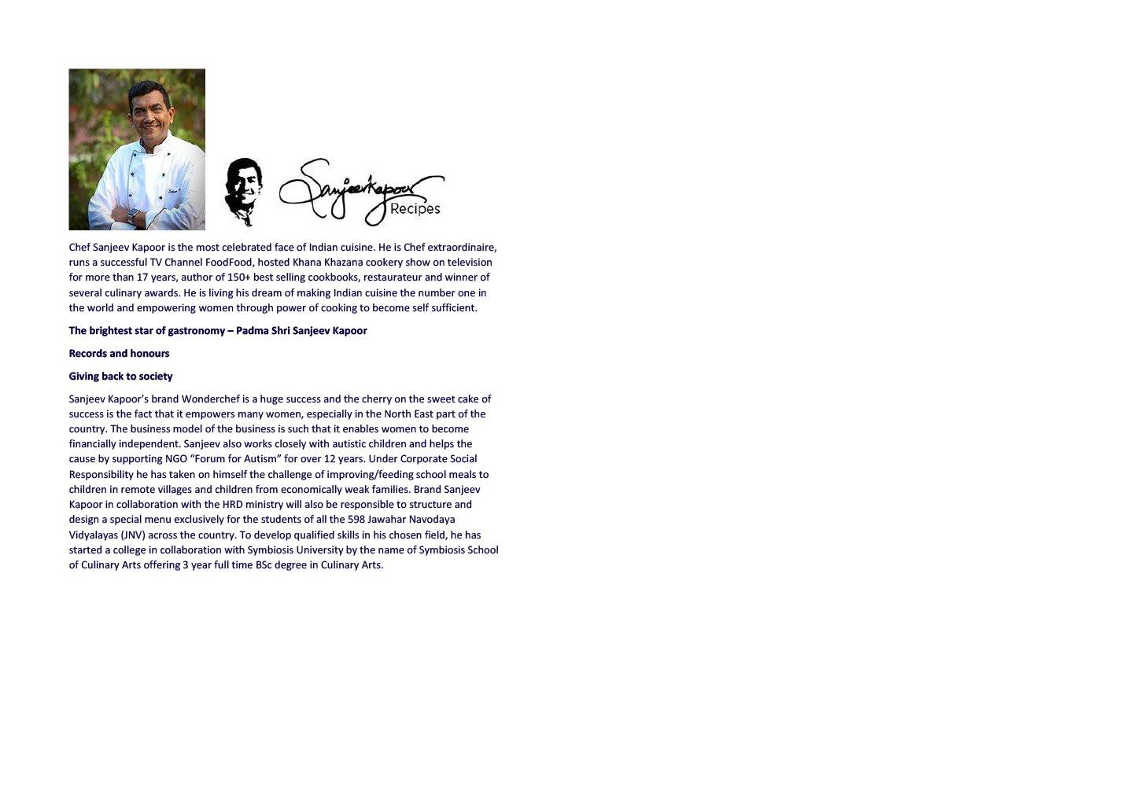
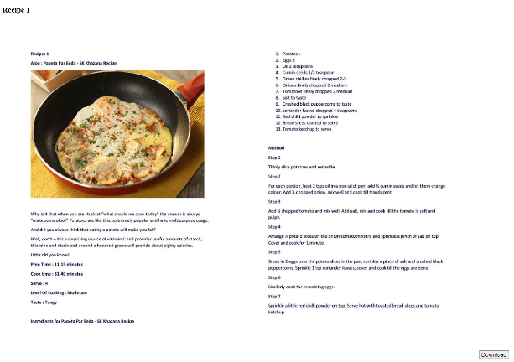
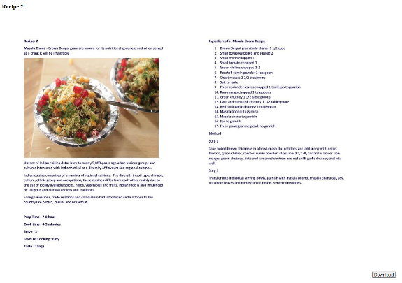
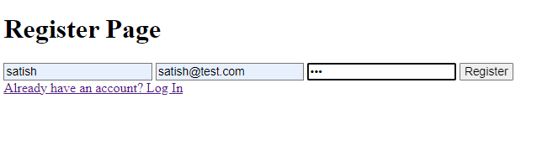
Actual Web Pages

Slide 4
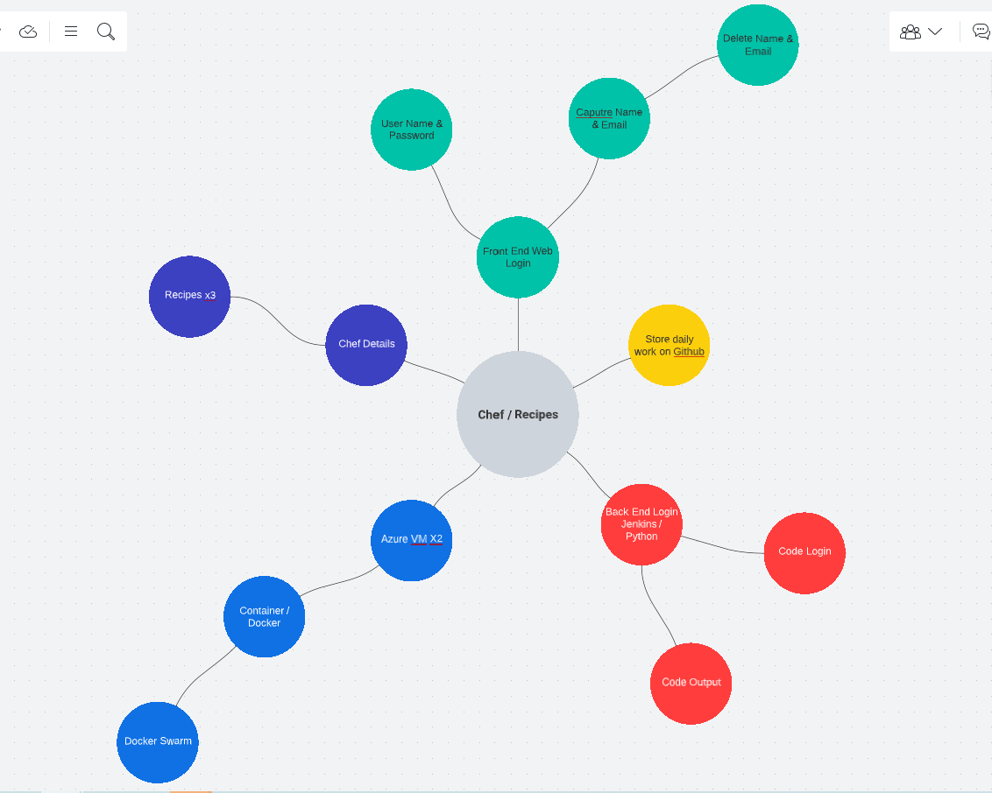
Web Tasks

Slide 5
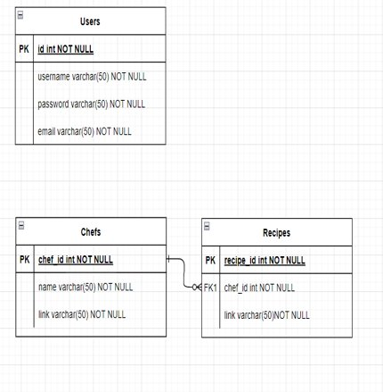
Database Table

Slide 6
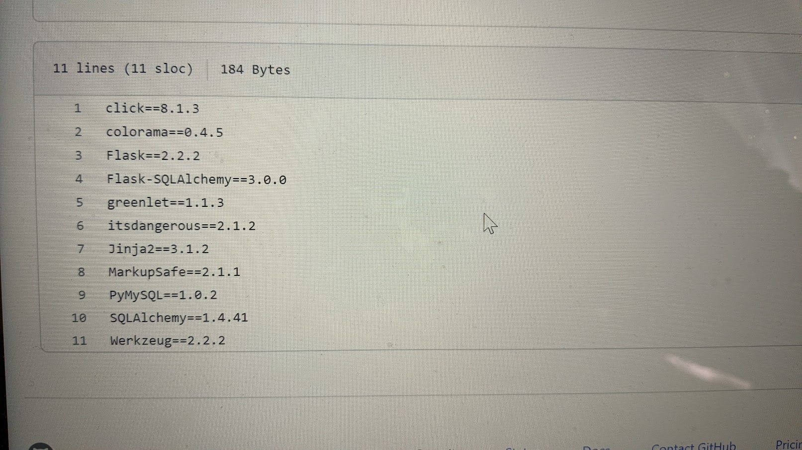
On GitHub (Jenkins pulls from GitHub, Push to Dockerhub, Create Docke Image

Slide 7
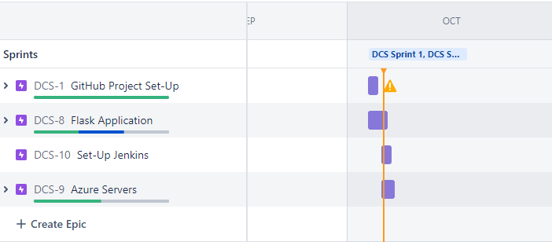
Jira Sprints

Slide 8
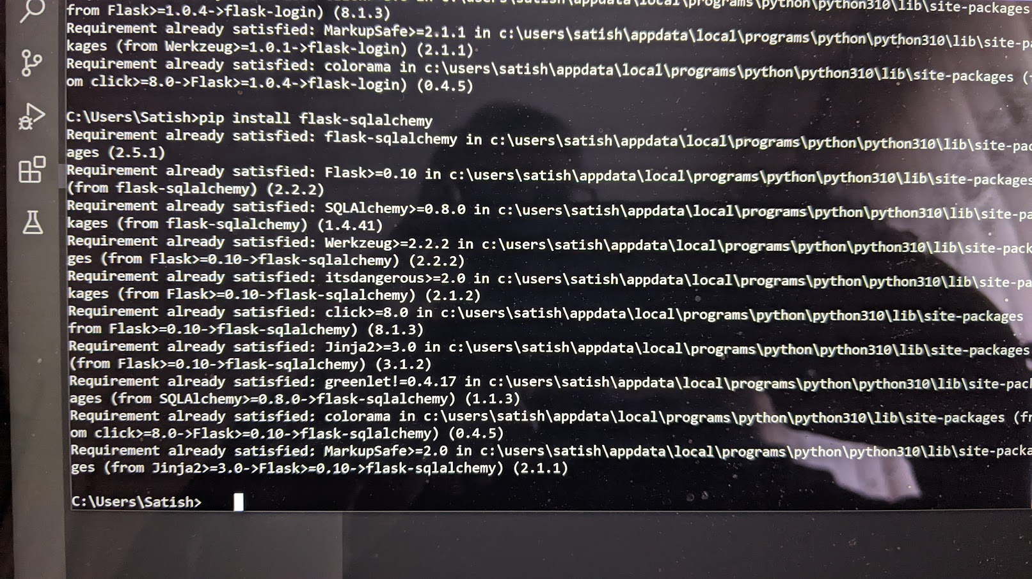
Add Flask

Slide 9
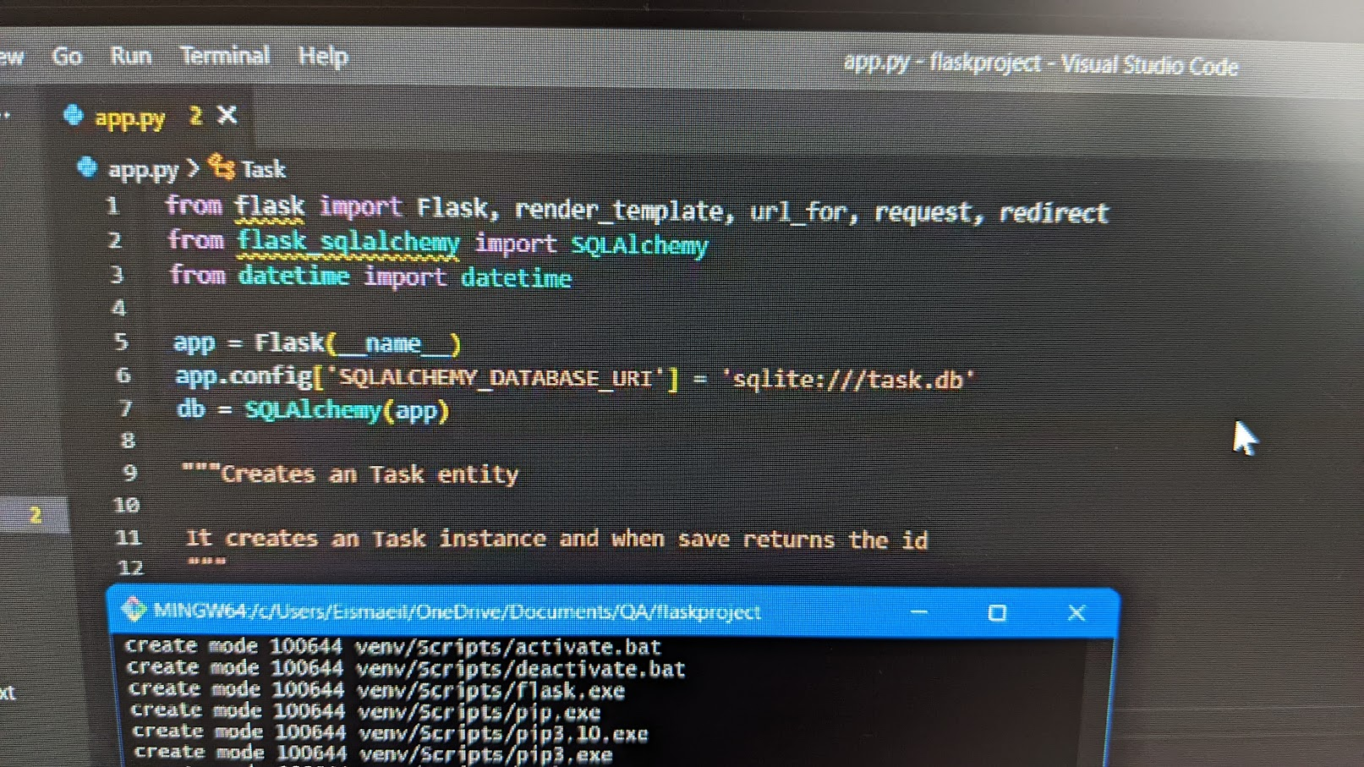
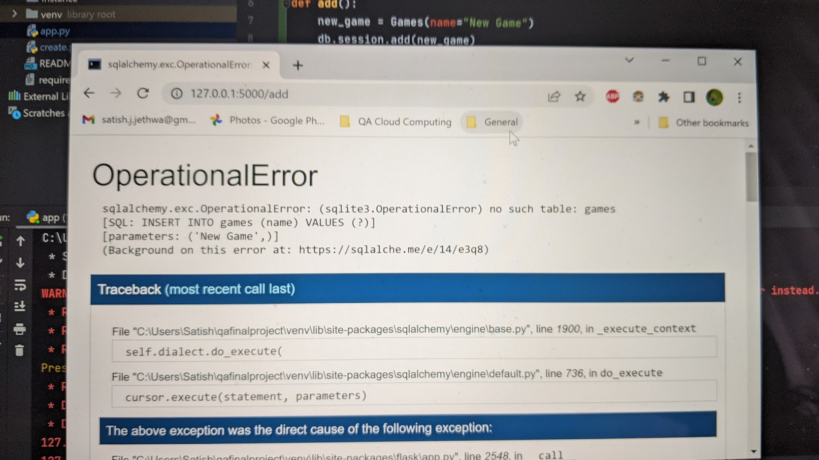
Sqlalchemey Error

Slide 10
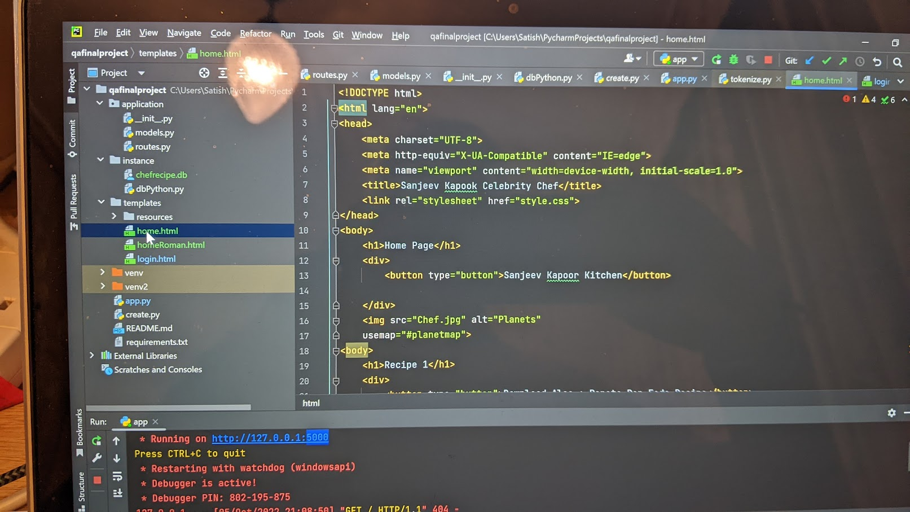
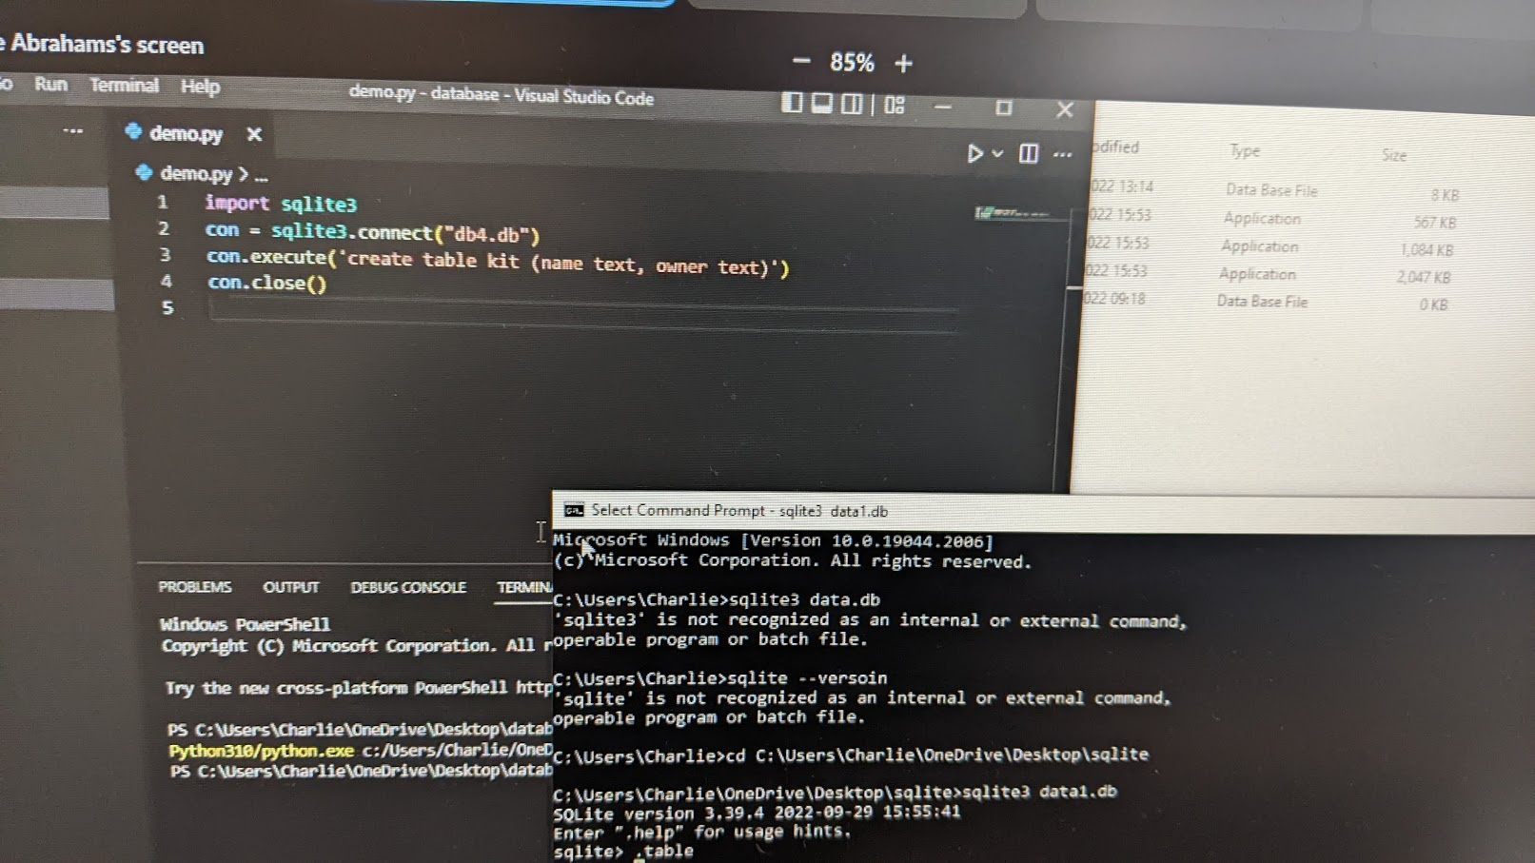
Loading Up PyCharm

Slide 11
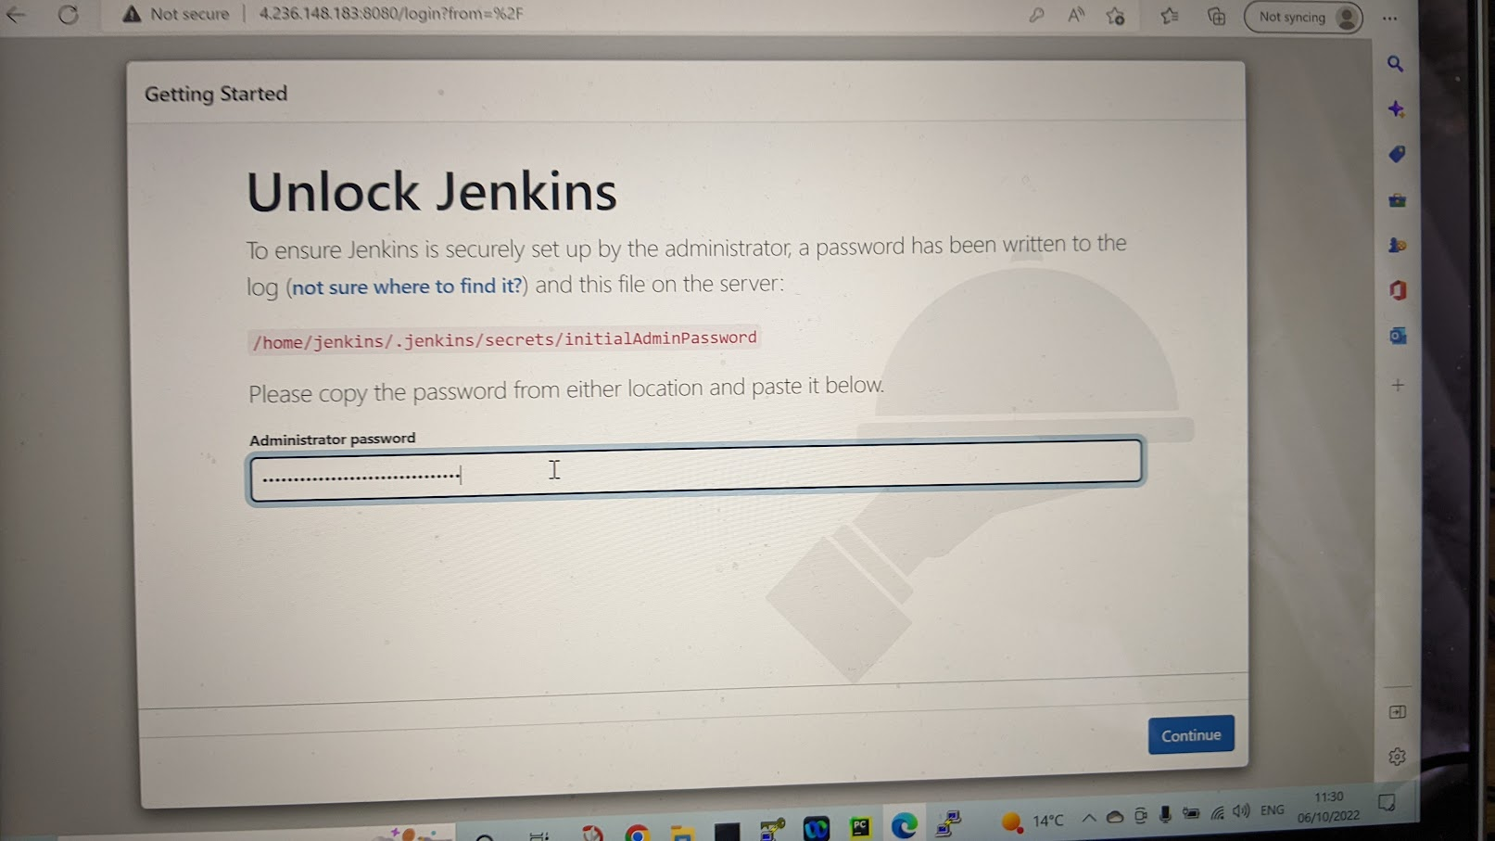
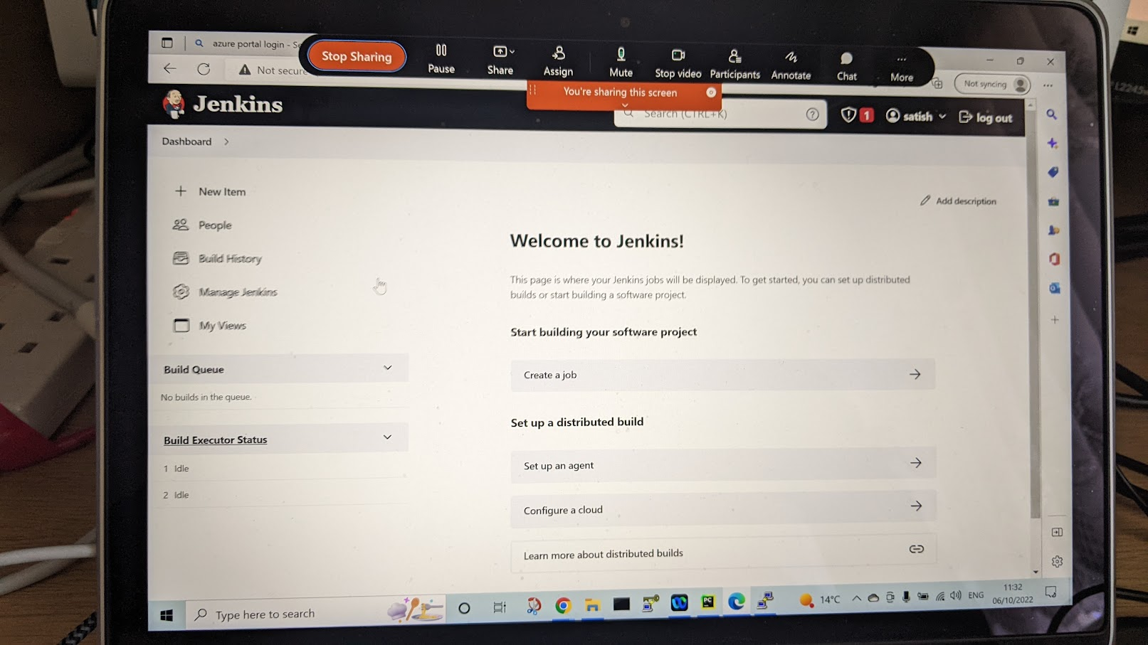
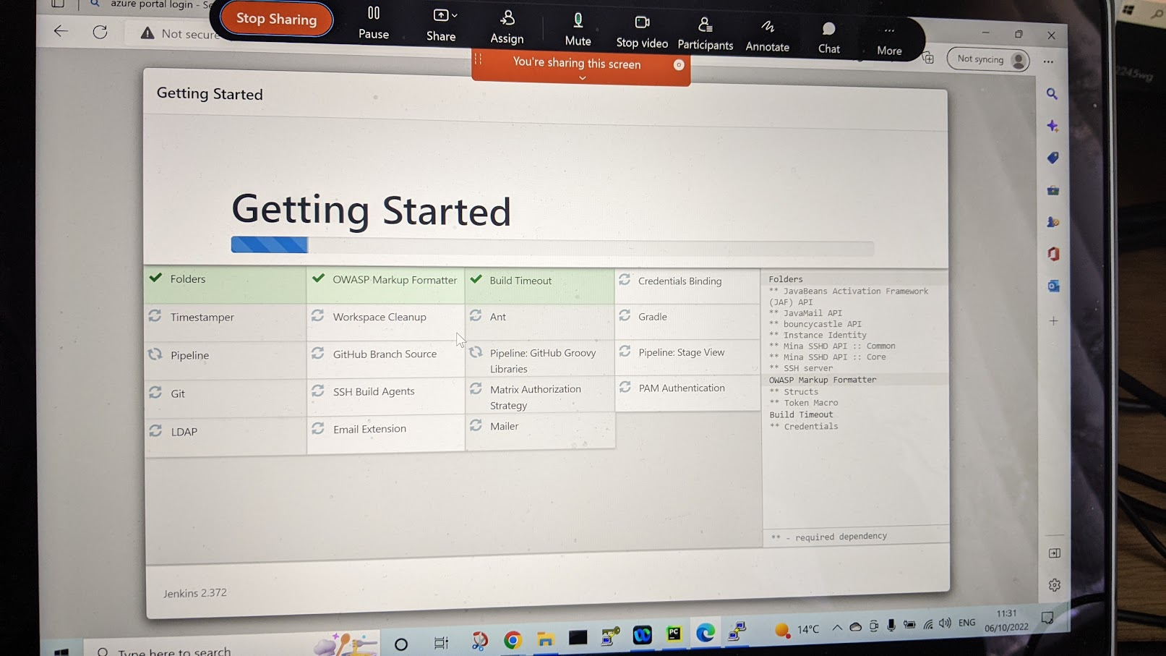
Setting Up Jenkins

Slide 12
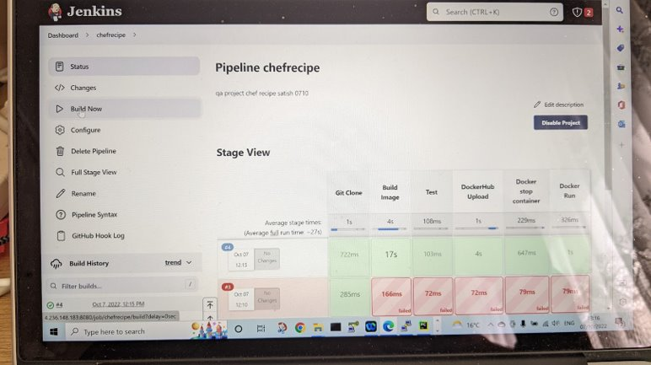
Jenkins Stage View

Slide 13
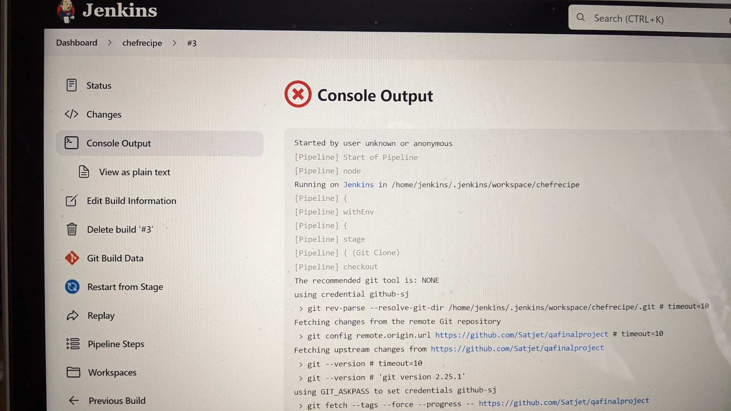
Console Output

Slide 14
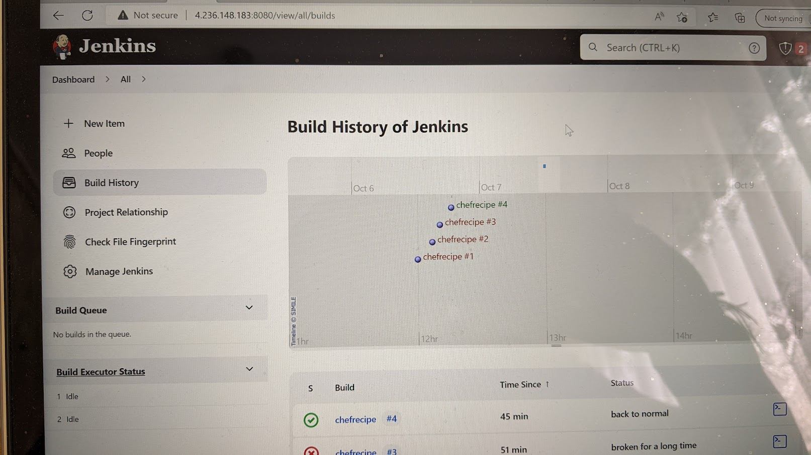
Jenkins Build History

Slide 15
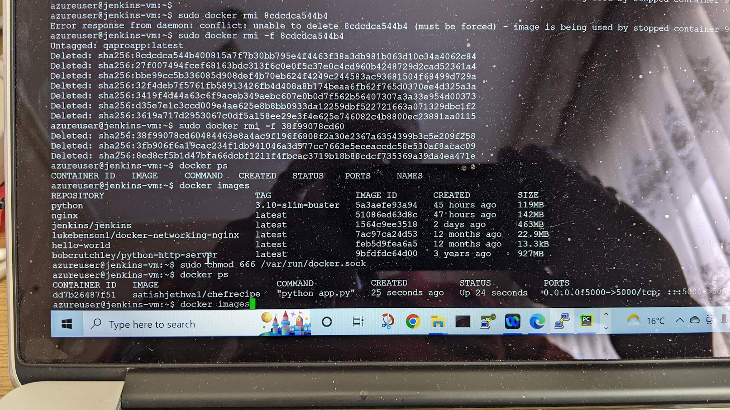
Docker Images

Slide 16
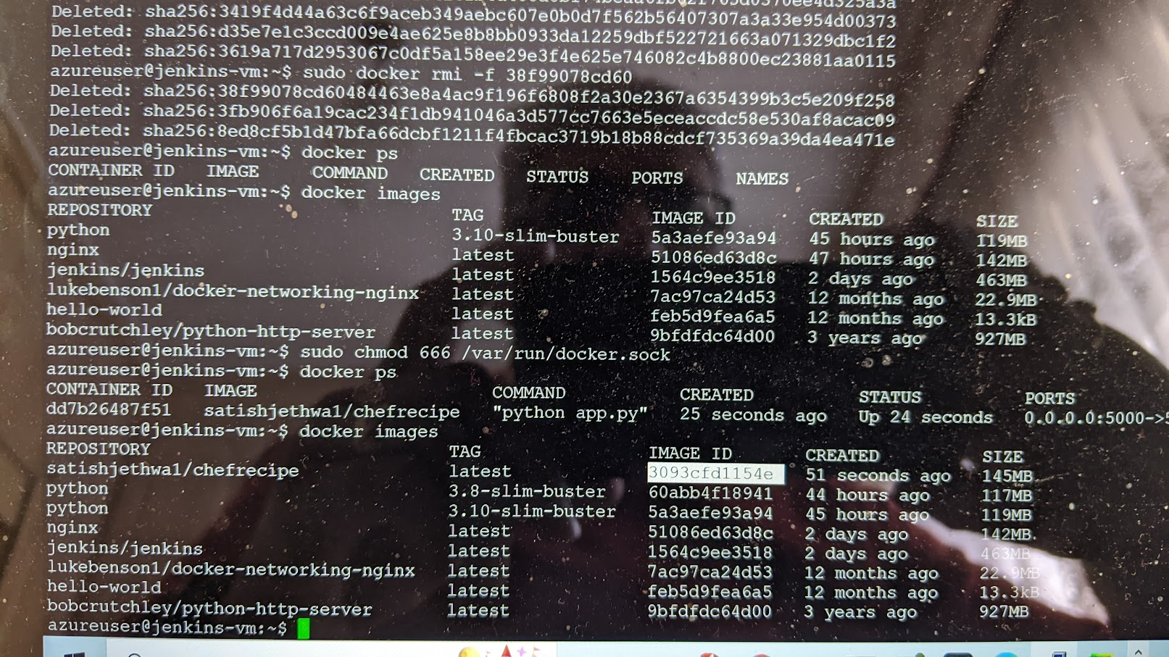
Image ID

Slide 17
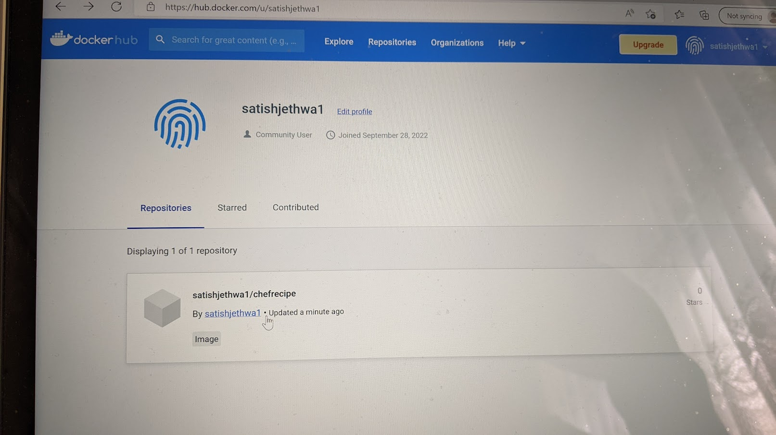
Docker Repository

Slide 18
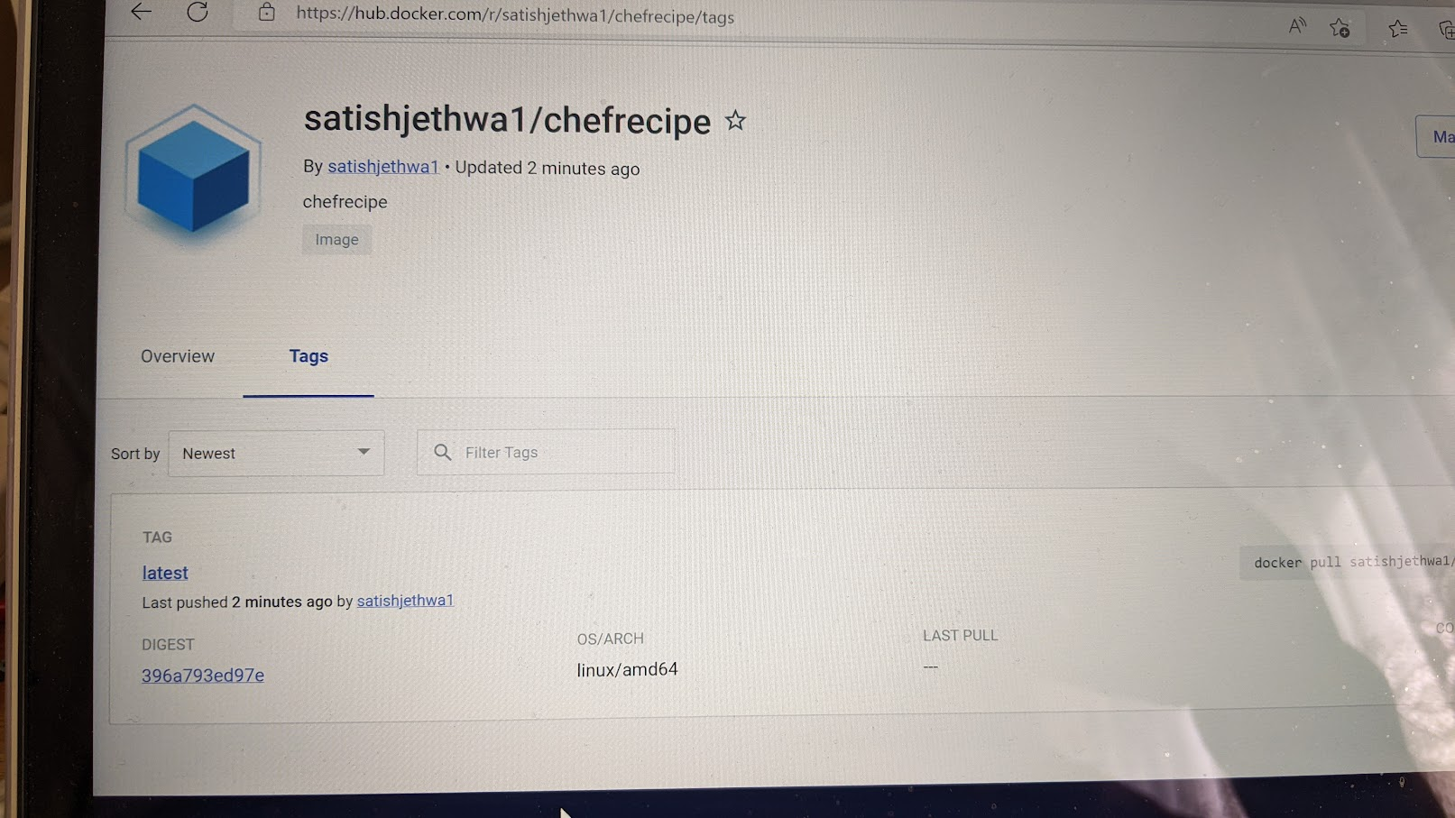
Doocker Tag

Slide 19
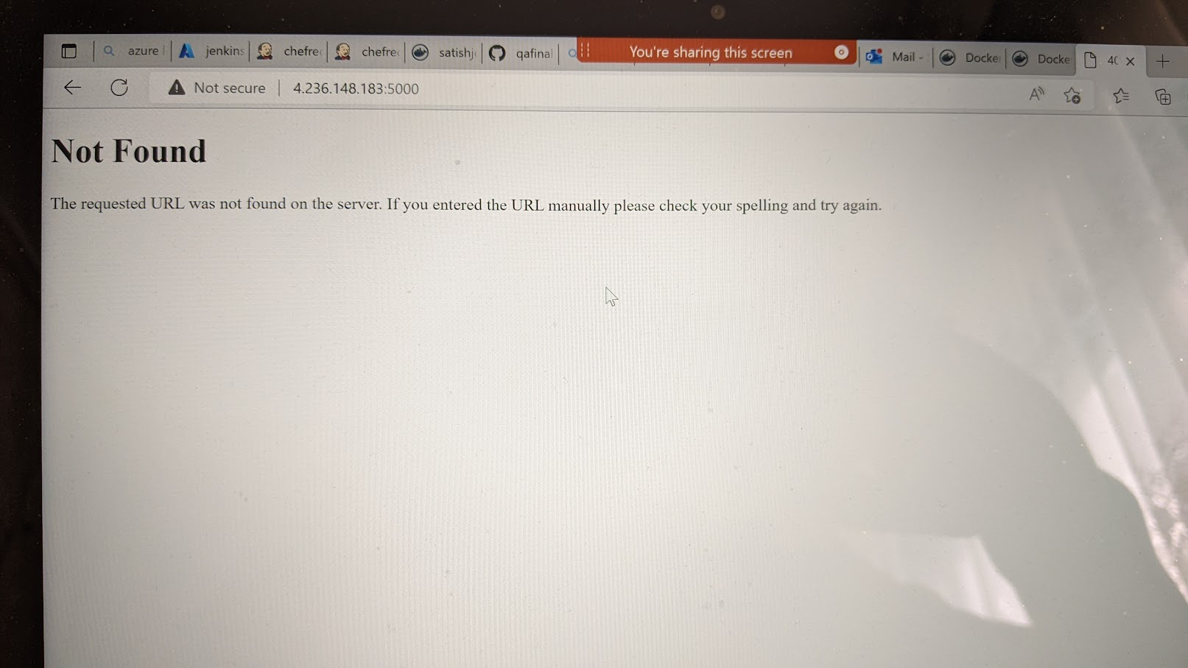
Error URL not found

Slide 20
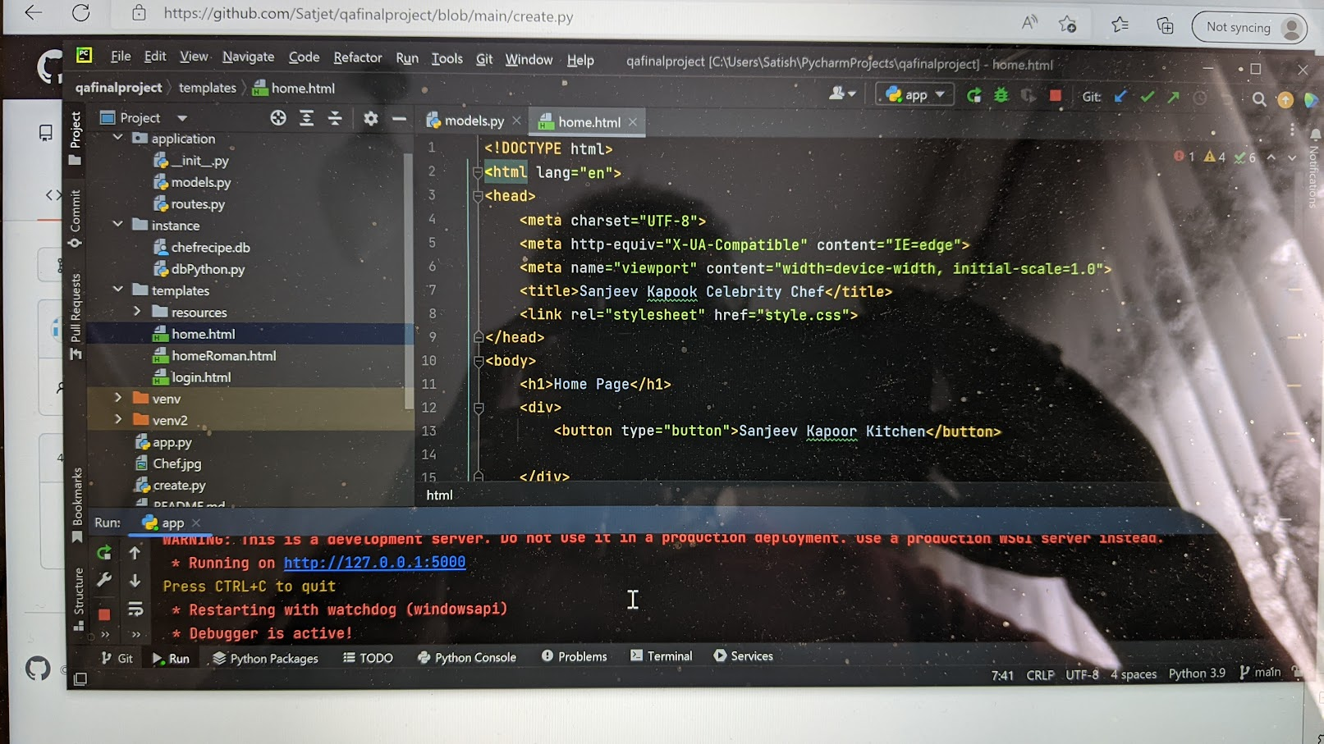
PyCharm

Slide 21
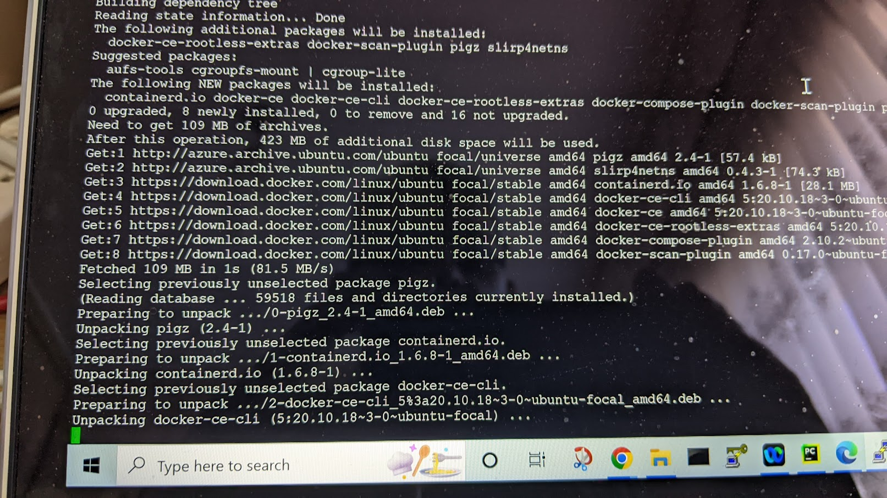
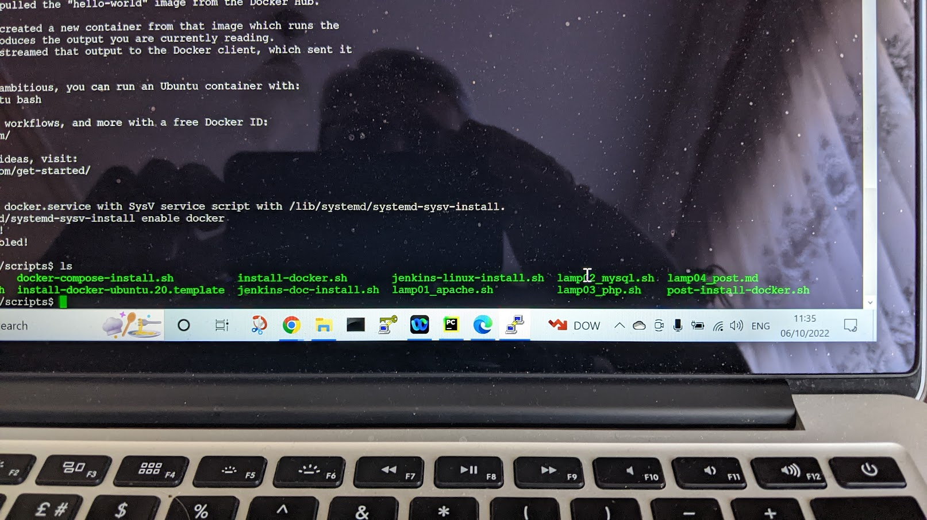
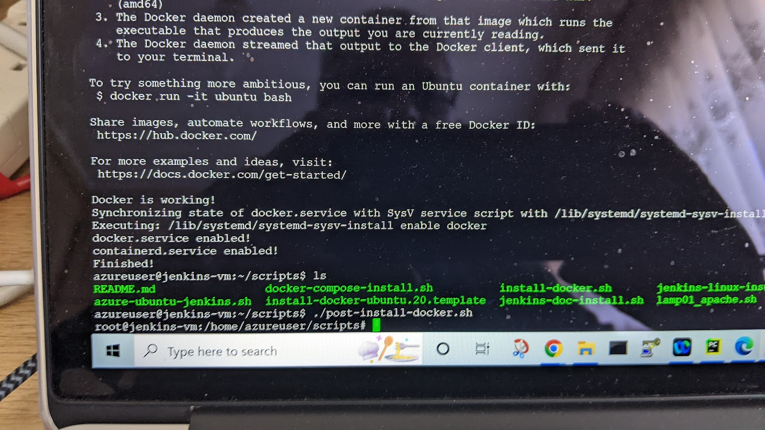
Back End Tasks: Docker / Container Build Up

Slide 22
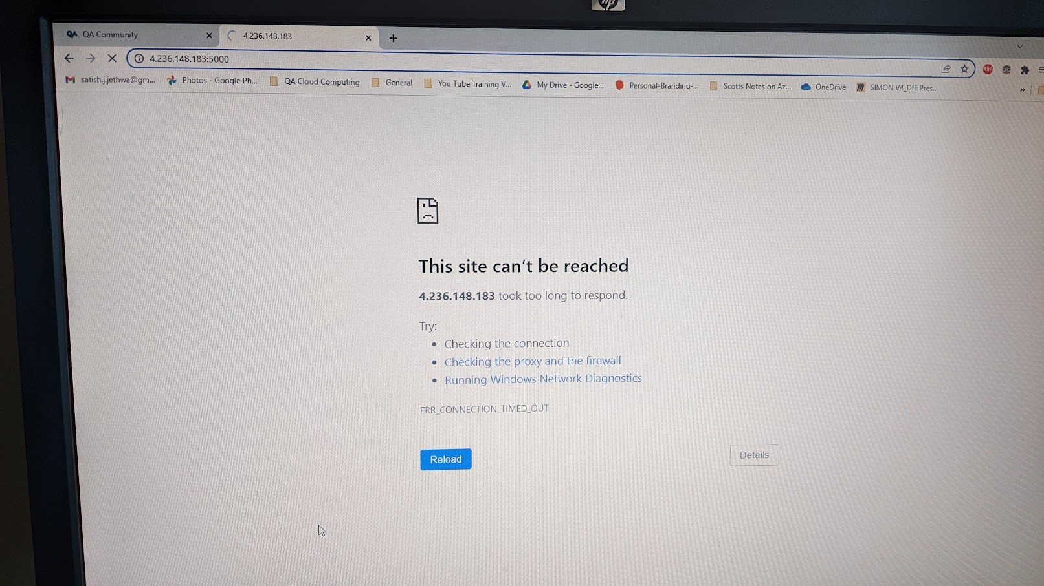
Errors : Images not showing up

Slide 23
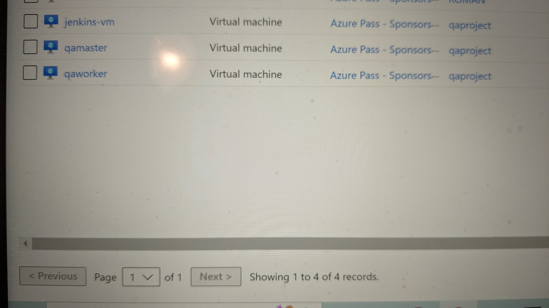
Install the 3 VM's

Slide 24
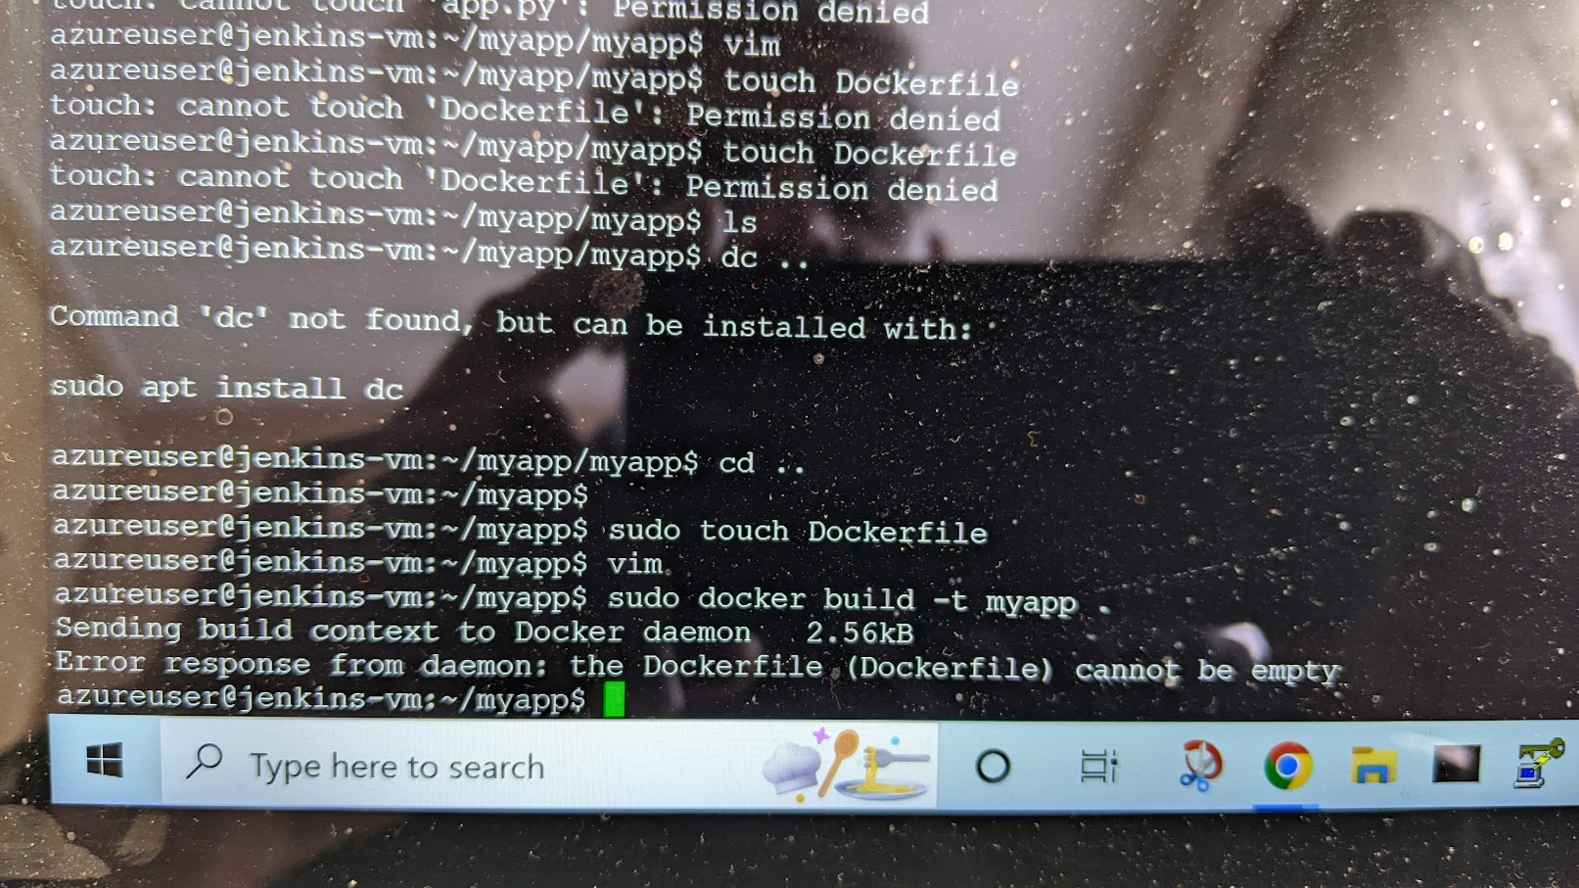
Error Tasks:

Slide 25
Build Tasks: Finally loaded up files

Slide 26
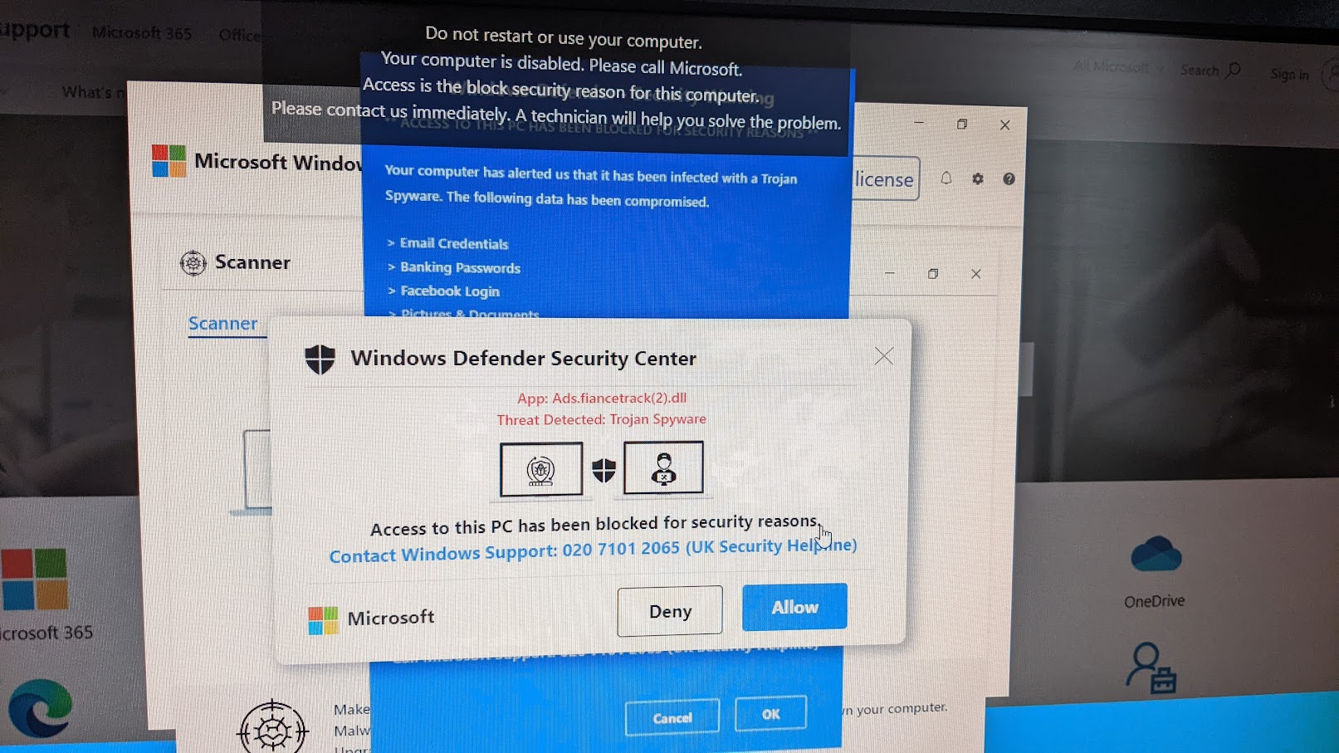
Lap HACKED by Trojan Spyware

Slide 27
Summary:
This project has been great and difficult as in one way it's made sure that I output what I have learnt over the 10 weeks.
Personally as a 58 year old I have been able to collate the intensive tutorials that have been First Class both on the QA Portal and the QA Tutors that have been true Professionals.
I have found putting the project together demanding as mentally in my mind it sit correctly like a puzzle, however when the apps crash and error upon errors occur it one step forward and 20 backwards.
Sadly I feel I have failed due to lack of time on finishing my project and my frustration on GitHub and Azure hence got help from a fellow student that I collaborated with to learn everything from start to finish as I wanted to see the end result of front end to back office.

Slide 28
A Big Thank You to All at QA & to all my fellow students.

Slide 30
QA Project
Satish Jethwa

Slide 31
Create Web App with Database
Project is to link up a Celebrity Chef with choice of 3 recipes for the user to select.

Slide 32
Web Tasks

Slide 33
Database Table

Slide 34
On GitHub (Jenkins pulls from GitHub, Push to Dockerhub, Create Docke Image

Slide 35
Jira Sprints

Slide 36
Add Flask

Slide 37
Sqlalchemey Error

Slide 38
Loading Up PyCharm

Slide 39
Setting Up Jenkins

Slide 40
Jenkins Stage View

Slide 41
Console Output

Slide 42
Jenkins Build History

Slide 43
Docker Images

Slide 44
Image ID

Slide 45
Docker Repository

Slide 46
Docker Tag

Slide 47
Error URL not found

Slide 48
PyCharm

Slide 49
Back End Tasks: Docker / Container Build Up

Slide 50
Errors : Images not showing up

Slide 51
Install the 3 VM's

Slide 52
Error Tasks:

Slide 53
Build Tasks: Finally loaded up files

Slide 54
Laptop HACKED by Phishing Website

Slide 55
Summary:
This project has been great and difficult as in one way it's made sure that I output what I have learnt over the 10 weeks.
Personally as a 58 year old I have been able to collate the intensive tutorials that have been First Class both on the QA Portal and the QA Tutors that have been true Professionals.
I have found putting the project together demanding as mentally in my mind it sits correctly like a puzzle, however when the apps crash and error upon errors occur it one step forward and 20 backwards.
Sadly I feel I have failed due to lack of time on finishing my project and my frustration on GitHub and Azure hence got help from a fellow student that I collaborated with to learn everything from start to finish as I wanted to see the end result of front end to back office.

Slide 56
Summary:
This project has been great and difficult as in one way it's made sure that I output what I have learnt over the 10 weeks.
Personally as a 58 year old I have been able to collate the intensive tutorials that have been First Class both on the QA Portal and the QA Tutors that have been true Professionals.
I have found putting the project together demanding as mentally in my mind it sit correctly like a puzzle, however when the apps crash and error upon errors occur it one step forward and 20 backwards.
Sadly I feel I have failed due to lack of time on finishing my project and my frustration on GitHub and Azure hence got help from a fellow student that I collaborated with to learn everything from start to finish as I wanted to see the end result of front end to back office.

Slide 57
Summary:
This project has been great and difficult as in one way it's made sure that I output what I have learnt over the 10 weeks.
Personally as a 58 year old I have been able to collate the intensive tutorials that have been First Class both on the QA Portal and the QA Tutors that have been true Professionals.
I have found putting the project together demanding as mentally in my mind it sit correctly like a puzzle, however when the apps crash and error upon errors occur it one step forward and 20 backwards.
Sadly I feel I have failed due to lack of time on finishing my project and my frustration on GitHub and Azure hence got help from a fellow student that I collaborated with to learn everything from start to finish as I wanted to see the end result of front end to back office.

Slide 58
A Big Thank You to All at QA & to all my fellow Students. Satish

